Slide 1
Java GUIs
An Introduction
CSA

Slide 2
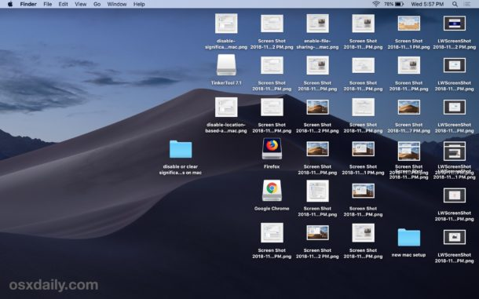
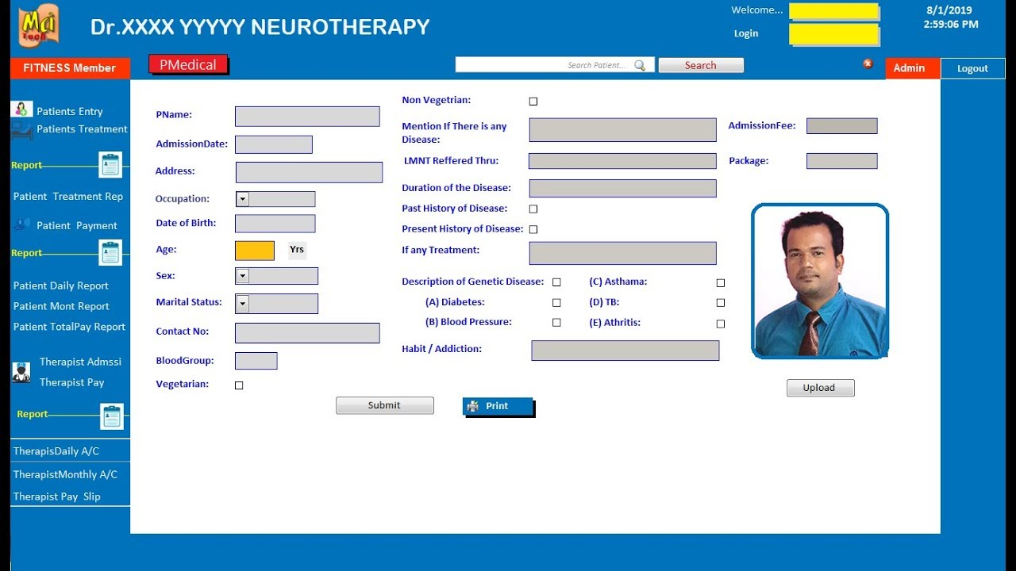
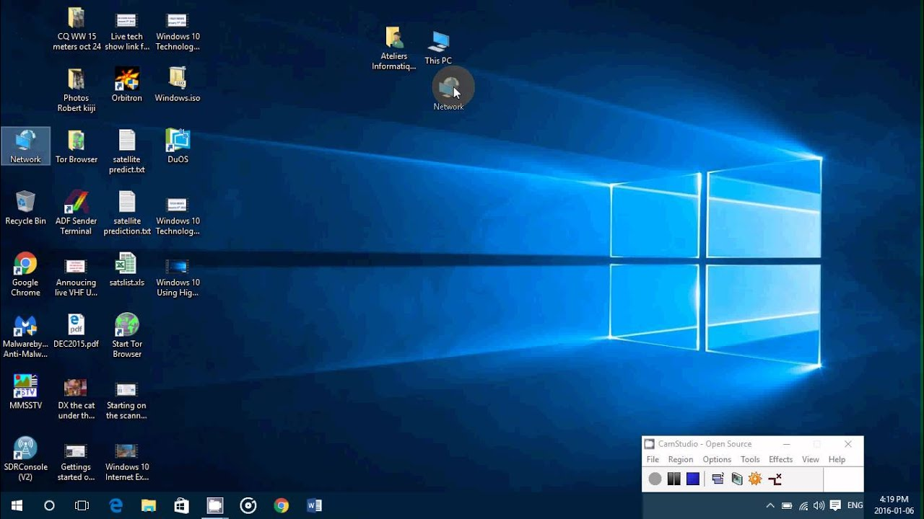
What is a GUI?
Graphical-User Interfaces

Slide 3
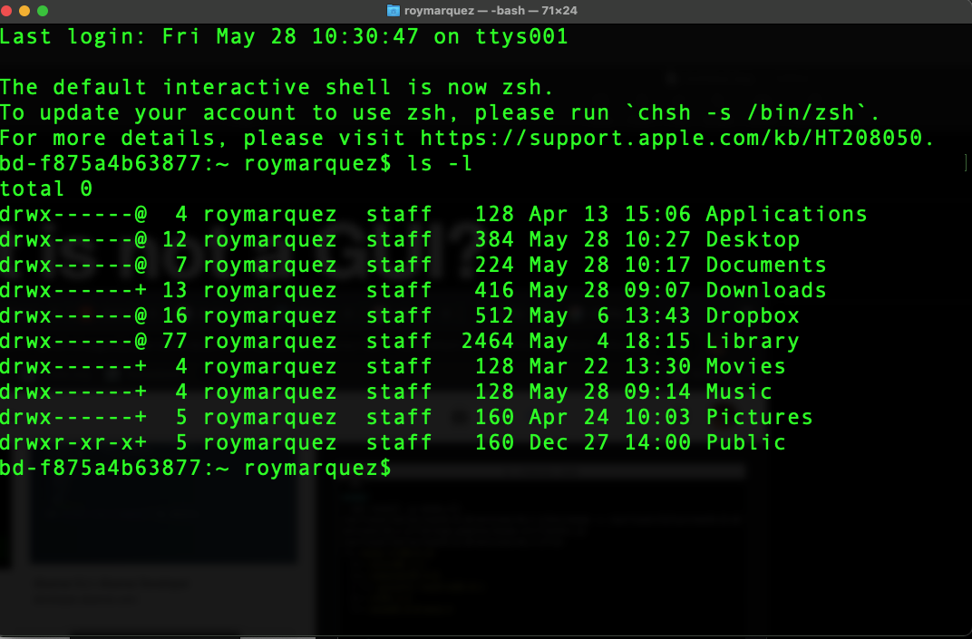
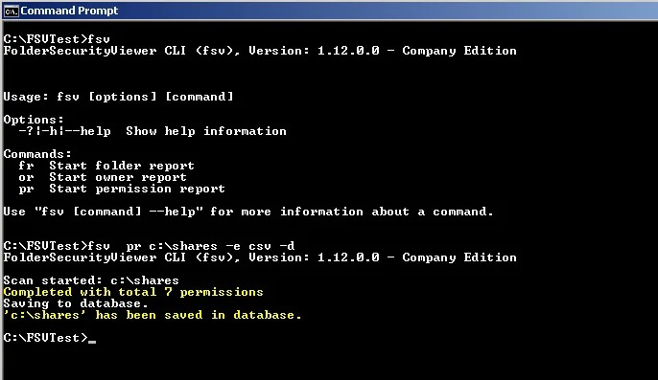
What is not a GUI?
Command-Line Interfaces

Slide 4
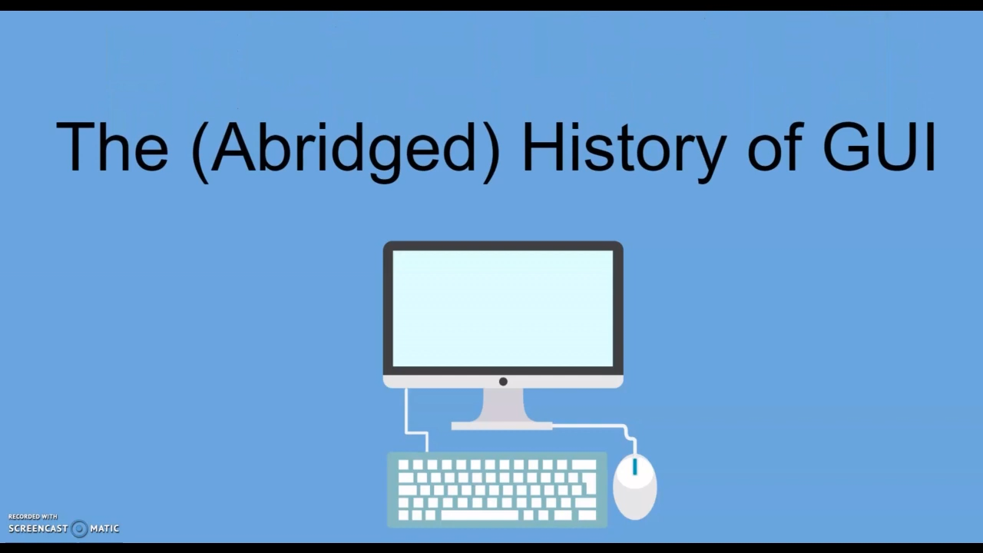

Slide 5
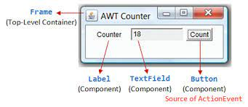
GUI Elements
What makes up a GUI?
Containers
JFrame
Components
JButton
JLabel
JTextField

Slide 6
Demo
AppLab

Slide 7
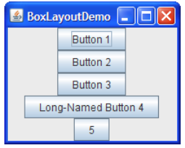
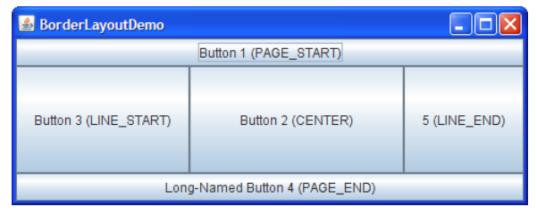
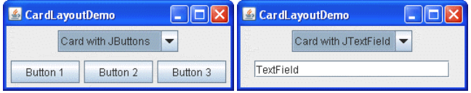
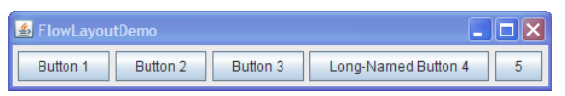
How do I Manage the Complexity of a GUI Design?
Layout Managers
A Layout Manage is used to arrange components in a container
BorderLayout
BoxLayout
CardLayout
FlowLayout
…

Slide 8
Demo
replit.com

